Slide 1
OKHEEI
2025 March Board Meeting
Daniel Somers, Pete Towne, Harmony Holloway and Summer Brown
March 4, 2026
Notes:
5-Option 2 Cover Page

Slide 2
Agenda
Renewal & Gallagher Support Recap
February Board Meeting Follow Up
Plan Performance Reporting
2026 Planning
Notes:
2-Agenda
Responsible to complete: CST – Update Year References

Slide 3
YOY Fixed Cost Renewal History
Recap | Response
BCBSOK 2024 Renewal Recap | 0% Increase in funding Starting in 2024, Flex Access was added to result in $700k estimated savings to Rx Specialty spend For 2024, Gallagher Pharmacy Team negotiated contract with Prime for an estimated 3-5% of savings In 2024, OKHEEI increased plan cost share to Blue Options Plans to decrease member cost share outside the state of Oklahoma In 24/25, OKHEEI streamlined the retiree eligibility process
BCBSOK 2025 Renewal Recap | Released Fixed cost Renewal at +86%; Revised Fixed Cost Renewal -88.7% ($531,188) Did not require a change in stop loss contracts Final renewal increase of 15.7% in funding (claims driven) Several Cost Containment Approaches were evaluated, below was executed Plan OOP Max’s & Rx Specialty Change - $794k est. savings Prime Formulary Move - $493k est. savings No New Laser provision in Stop Loss Contract Realignment of Employee Contribution Strategy by College – Savings ranged by college
BCBSOK 2026 Renewal Recap | Released Fixed cost Renewal at +18%; Revised Fixed Cost Renewal -58.5% ($444,176) Did not require a change in stop loss contracts Final renewal increase of 9% in funding (claims driven) Several Cost Containment Approaches were evaluated, below was executed Moving All Plans to Blue Advantage network for larger network discounts and increasing OOP Max on Plan C by $500 Add Plan equal to $2,000 Plan, but with Blue Options Worked on Employee Contribution Strategy by College – Savings ranged by college Moved Advantage and PDP to BCBS for immediate savings

Slide 4
2026 Support Recap
Stop Loss Audit for maximization of stop loss reimbursements
Escalated Claims Issues
Annual Rebate Reconciliation with BCBS
  2025 – Anticipated in March 2026
  2024 - $919,664 savings
  2023 - $681,198 savings
Weight Loss Therapy Pharmacy Review
AJG Medicare Consultant Meetings - Southwestern
FMLA Administration Guidance
Telemedicine - Members can contribute to an HSA and access telemedicine benefits without satisfying the deductible
Flexible Spending Accounts - Dependent Care limit increase from $5,000 to $7,500 in 2026
Train the Trainer – In Person TBD
Monthly Benefit Coordinator Meetings
** Long Term Care Implementation **

Slide 5
February Board Meeting Follow Up
Notes:
5-Divider slide
Responsible to complete: GSC

Slide 6
Meeting Follow Up
Preventive Care Utilization
Wellness Screenings – Copay being charged
  Gallagher looked into several individual claims data to verify no copay was charged for a preventive claim.
Request additional preventive claims insight from BCBS – See BCBS Report
Mobile screening services demo – March 26th Demo?
Out Of State Employees
Active subscribers: 181
Retirees, Retiree Spouse, and Surviving Spouse: 172
Pre-65 Retiree
Funding modeling coming for renewal – Retirees
ran $532.72 PEPM over budget.
How many HCC are pre-65? 5 & all subscribers
  $1.22 Million in paid claims

Slide 7
Plan Performance Reporting
Notes:
7-Divider slide
Responsible to complete: GSC

Slide 8
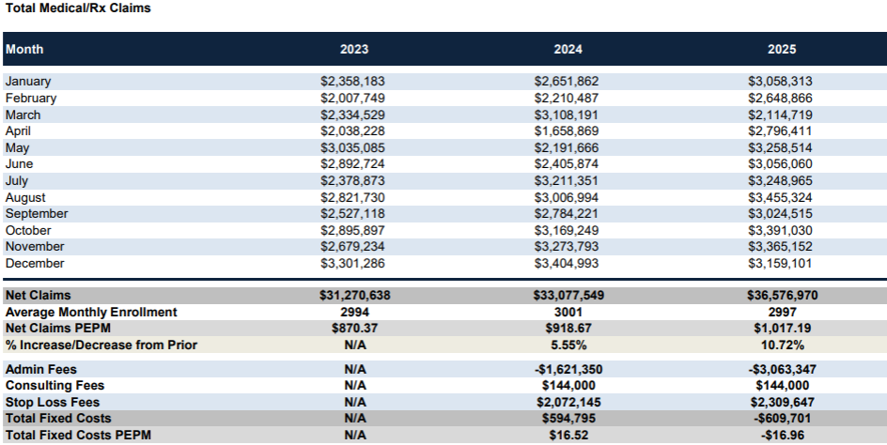
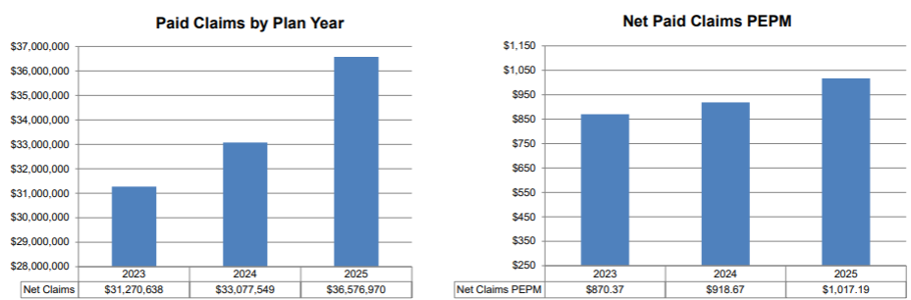
Historical Plan Cost Summary
Notes:
18- 20[CY] Enrollment Outcomes
Responsible to complete: GSC
Source: prior year renewal proposal, carrier bills, FMR, census
Notes: CST must provide links to the desired data source (because this data is available in multiple sources, we want to avoid the GSC using a different source than the CST wants, thus requiring a rework). There are 3 plan types, reference by deductible type.
DMS link: 2023 enrollment: https://gbsdms.ajgco.com/oklahoma-city/Accounts/City%20National%20Bank%20Lawton/City%20National%20Bank_Invoice_BCBSOK_Medical%20Dental_20230101.pdf
2022 enrollment: https://gbsdms.ajgco.com/oklahoma-city/Accounts/City%20National%20Bank%20Lawton/City%20National%20Bank%20_Marketin%20Spreadsheet_COMBINED_20220101.xlsm

Slide 9
Historical Analysis
The information contained herein is subject to the disclosures and disclaimers on the Disclaimers page of this presentation.
Notes:
18- 20[CY] Enrollment Outcomes
Responsible to complete: GSC
Source: prior year renewal proposal, carrier bills, FMR, census
Notes: CST must provide links to the desired data source (because this data is available in multiple sources, we want to avoid the GSC using a different source than the CST wants, thus requiring a rework). There are 3 plan types, reference by deductible type.
DMS link: 2023 enrollment: https://gbsdms.ajgco.com/oklahoma-city/Accounts/City%20National%20Bank%20Lawton/City%20National%20Bank_Invoice_BCBSOK_Medical%20Dental_20230101.pdf
2022 enrollment: https://gbsdms.ajgco.com/oklahoma-city/Accounts/City%20National%20Bank%20Lawton/City%20National%20Bank%20_Marketin%20Spreadsheet_COMBINED_20220101.xlsm

Slide 10
Year over Year Large Claim Trend
2017 – 2025
29
24
23
14
12
14
15
9
11
Note: Blue boxes represent # of members that exceeded $150k in claims
2023 – Above members represent $5,567,852 in paid claims
2024 – Above members represent $6,829,824 in paid claims
2025 – Above members represent $7,527,347 in paid claims
Notes:
Sub in oncology focus if more relevant

Slide 11
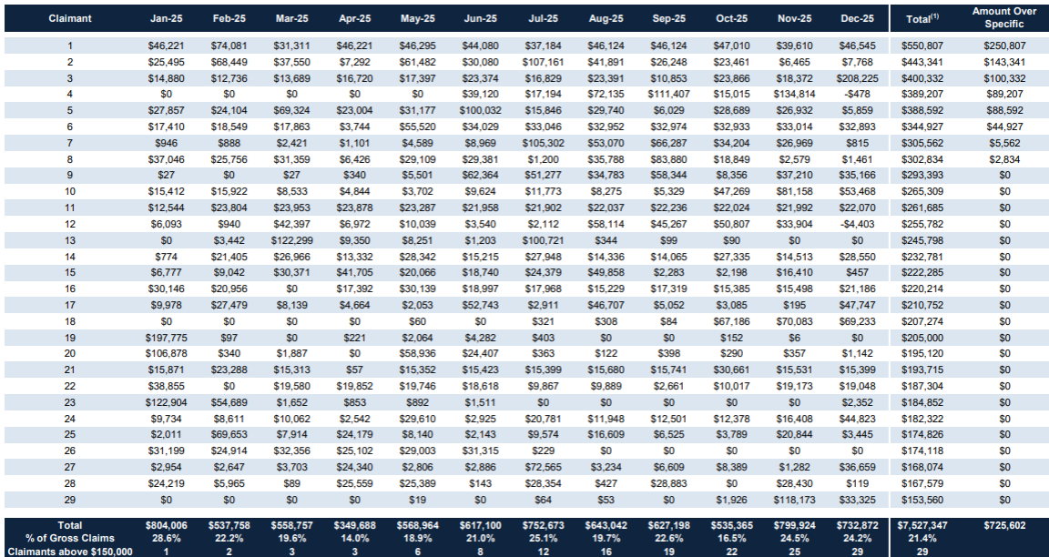
2025 Large Claimants
termed
termed
termed
termed
termed
Highlighted yellow arrow shows large claimants increased significantly in cost after stop loss renewal had been locked in. Benefit of OKHEEI is early lock in. Most plans can not lock until August
The information contained herein is subject to the disclosures and disclaimers on the Disclaimers page of this presentation.
Notes:
18- 20[CY] Enrollment Outcomes
Responsible to complete: GSC
Source: prior year renewal proposal, carrier bills, FMR, census
Notes: CST must provide links to the desired data source (because this data is available in multiple sources, we want to avoid the GSC using a different source than the CST wants, thus requiring a rework). There are 3 plan types, reference by deductible type.
DMS link: 2023 enrollment: https://gbsdms.ajgco.com/oklahoma-city/Accounts/City%20National%20Bank%20Lawton/City%20National%20Bank_Invoice_BCBSOK_Medical%20Dental_20230101.pdf
2022 enrollment: https://gbsdms.ajgco.com/oklahoma-city/Accounts/City%20National%20Bank%20Lawton/City%20National%20Bank%20_Marketin%20Spreadsheet_COMBINED_20220101.xlsm

Slide 12
2025 Large Claimants
KEY NOTES:
2022 – 15 Claimants over $150,000 in claims - 3 Claimants over $300,000 Spec
2023 – 23 Claimants over $150,000 in claims - 5 Claimants over $300,000 Spec
2024 – 25 Claimants over $150,000 in claims – 7 Claimants over $300,000 Spec
  19 were employees, 6 were dependents
  7 claimants were cancer
  9 claimants had prescription drugs over $100,000
2025 – 29 Claimants over $150,000 in claims - 8 Claimants over $300,000 Spec
  21 were employees, 8 were dependents
  12 claimants were cancer
  8 claimants had prescription drugs over $100,000
Notes:
18- 20[CY] Enrollment Outcomes
Responsible to complete: GSC
Source: prior year renewal proposal, carrier bills, FMR, census
Notes: CST must provide links to the desired data source (because this data is available in multiple sources, we want to avoid the GSC using a different source than the CST wants, thus requiring a rework). There are 3 plan types, reference by deductible type.
DMS link: 2023 enrollment: https://gbsdms.ajgco.com/oklahoma-city/Accounts/City%20National%20Bank%20Lawton/City%20National%20Bank_Invoice_BCBSOK_Medical%20Dental_20230101.pdf
2022 enrollment: https://gbsdms.ajgco.com/oklahoma-city/Accounts/City%20National%20Bank%20Lawton/City%20National%20Bank%20_Marketin%20Spreadsheet_COMBINED_20220101.xlsm

Slide 13
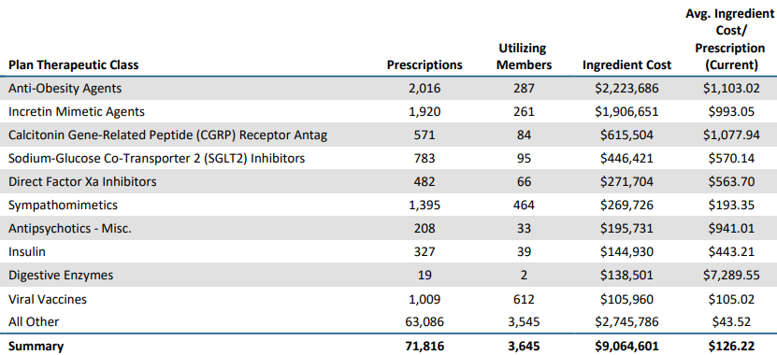
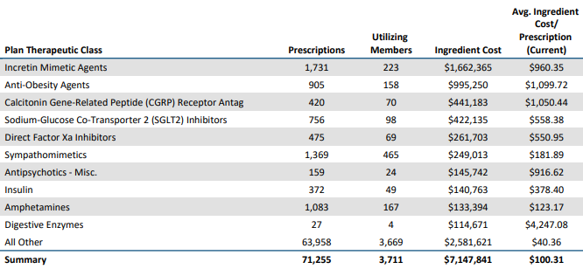
Top Non-Specialty Drugs by Plan Paid
2025
Anti-Obesity Rx has increase from 905 to 2,016 prescriptions
Cost to the Plan has been $1,228,436 which accounts for 41% of the budget deficit
2024
Notes:
18- 20[CY] Enrollment Outcomes
Responsible to complete: GSC
Source: prior year renewal proposal, carrier bills, FMR, census
Notes: CST must provide links to the desired data source (because this data is available in multiple sources, we want to avoid the GSC using a different source than the CST wants, thus requiring a rework). There are 3 plan types, reference by deductible type.
DMS link: 2023 enrollment: https://gbsdms.ajgco.com/oklahoma-city/Accounts/City%20National%20Bank%20Lawton/City%20National%20Bank_Invoice_BCBSOK_Medical%20Dental_20230101.pdf
2022 enrollment: https://gbsdms.ajgco.com/oklahoma-city/Accounts/City%20National%20Bank%20Lawton/City%20National%20Bank%20_Marketin%20Spreadsheet_COMBINED_20220101.xlsm

Slide 14
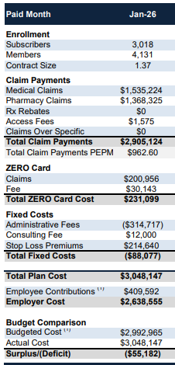
2026 Plan Cost Summary
Average enrollment in 2025 was 2,297
2026 started at 3,018
Pharmacy claims are 36% of total cost
No large claimants over $150,000
February Med and Pharm claims are appearing to be lower than average months
The information contained herein is subject to the disclosures and disclaimers on the Disclaimers page of this presentation.
Notes:
18- 20[CY] Enrollment Outcomes
Responsible to complete: GSC
Source: prior year renewal proposal, carrier bills, FMR, census
Notes: CST must provide links to the desired data source (because this data is available in multiple sources, we want to avoid the GSC using a different source than the CST wants, thus requiring a rework). There are 3 plan types, reference by deductible type.
DMS link: 2023 enrollment: https://gbsdms.ajgco.com/oklahoma-city/Accounts/City%20National%20Bank%20Lawton/City%20National%20Bank_Invoice_BCBSOK_Medical%20Dental_20230101.pdf
2022 enrollment: https://gbsdms.ajgco.com/oklahoma-city/Accounts/City%20National%20Bank%20Lawton/City%20National%20Bank%20_Marketin%20Spreadsheet_COMBINED_20220101.xlsm

Slide 15
Wellness Visits
Preventive visits are vital to early detection and prevention.
OKHEEI covers Preventive and Routine visits at 100%
Notes:
18- 20[CY] Enrollment Outcomes
Responsible to complete: GSC
Source: prior year renewal proposal, carrier bills, FMR, census
Notes: CST must provide links to the desired data source (because this data is available in multiple sources, we want to avoid the GSC using a different source than the CST wants, thus requiring a rework). There are 3 plan types, reference by deductible type.
DMS link: 2023 enrollment: https://gbsdms.ajgco.com/oklahoma-city/Accounts/City%20National%20Bank%20Lawton/City%20National%20Bank_Invoice_BCBSOK_Medical%20Dental_20230101.pdf
2022 enrollment: https://gbsdms.ajgco.com/oklahoma-city/Accounts/City%20National%20Bank%20Lawton/City%20National%20Bank%20_Marketin%20Spreadsheet_COMBINED_20220101.xlsm

Slide 16
2026 Strategic Solutions
What does a successful 2026 look like to you?
Notes:
16- Divider slide
Responsible to complete: GSC

Slide 17
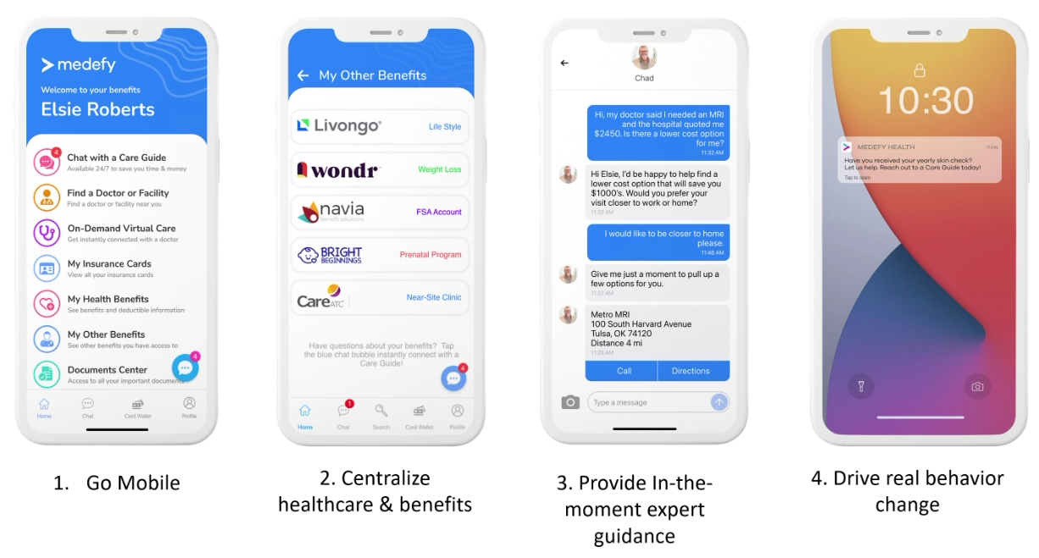
Considerations
HRPro FSA Consideration
Go To Doctor Campaign – 1,464 of 4,172 had a face-to-face preventive visit in 2025
Biometric Wellness Screenings
Care Navigation Tools:

Slide 18
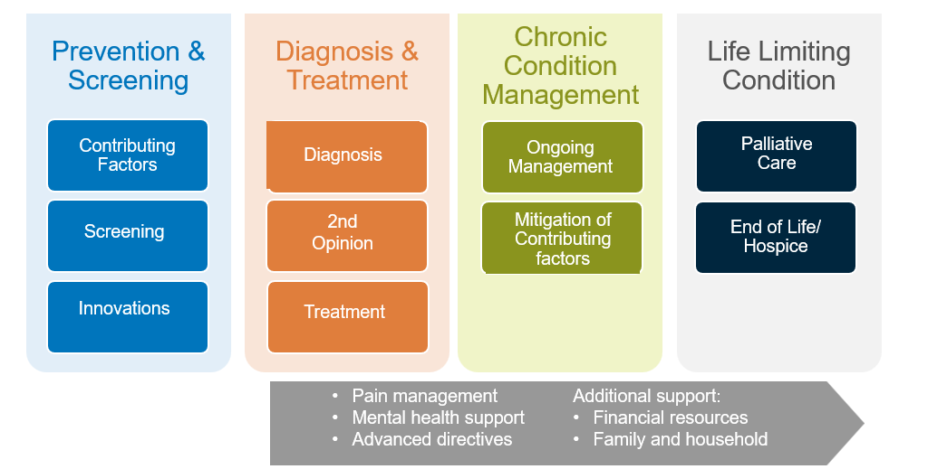
Cancer Care Continuum
Clinical and financial risk, as well as the member experience
**
* Cancer Facts & Figures 2023. American Cancer Society
** Survivor View: Cancer & Medical Debt. February 2022 Survey Findings Summary. American Cancer Society
Notes:
There are four main areas of cost to the employer in the cancer care continuum
I’ll walk you thru a few points for each. (Choose items that fit your client’s specific situation and population needs to discuss)
1) First, understand the population’s cancer risk and finding cancers earlier
Contributing factors for cancer include ones we all know: healthy eating, increase physical activity, decrease alcohol intake, don’t smoke and reduce environmental risks factors
what’s often overlooked is that obesity is a significant risk for at least 13 cancers, including kidney, pancreatic, esophageal, stomach and others…
this is significant, given that 42% of the US adult population is considered obese
2) Diagnosis and treatment-often the most costly cancer phase
Chemotherapy/specialty drugs are often a big part of that cost
One of these, Immunotherapy, is a true game changer. Easy way to think of it is: Some chemotherapy typically kills healthy cells in the body, not just the cancer cells—so lots of side effects, often developing additional problems to the cancer.
The newer treatments, such as immunotherapy, are more targeted. They use your own immune system and selectively target just the cancer cells– which minimizes treatment side effects and better outcomes-- but currently it comes with a high price tag
Offering a second opinion program can be very important with cancer diagnosis
Recent studies have shown that 1 in every 5 patients with a dx of cancer may have the wrong diagnosis
No one wants to waste money for a treatment that isn’t working
A wrong diagnosis of cancer, or the wrong type of cancer diagnosed can lead to over treatment, under treatment or simply the wrong treatment all together
3) Remember that Cancer is a chronic condition—it doesn’t go away, it is ongoing vigilance, surveillance and screening- monitoring for early signs of cancer reoccurrence, new cancers and taking care of the whole body, including mental health needs
Ongoing support consideration are in the grey arrow… AND are typically needed across the three phases.
4) The final phase is typically when the cancer has metastasized, or spread and is no longer treatable. Strong care navigation programs can help to advocate palliative care and hospice for patients. Palliative care and/or hospice (when the time is right) typically either reduces overall cost or is cost neutral and improves quality of life and end-of-life experience for the patient and their loved ones.
What is more challenging for the health care system, is making sure patients are identified for palliative care and hospice in a timely manner-- when the member and their loved ones can actually benefit from the services.
Cost Savings Associated With Palliative Care Among Older Adults With Advanced Cancer - PubMed (nih.gov)
palliative_care_effects_on_costs_11-18-22_update.pdf (fightcancer.org)
Consultants:
Use slide 11, The Cancer Care Continuum (Employer Strategies) as a reference to customize this slide so it reflects the client’s unique situation and needs—and will better support the client conversation
See additional actions or considerations below:
Screening and Early Detection–
Work with health plan or vendor partners to identify high risk employees and notifying them when they are due for a cancer screening
Consider offering an incentive to complete cancer screenings
Explore alternative screening options, including at-home tests, when possible, to reduce barriers and improve screening rates
Consider covering MCED tests for eligible employees/family members
2) Diagnosis and Treatment
Cancer COEs
provides employees to high quality providers and can be particularly helpful for rare, aggressive and difficult-to-treat cancers
Ideally, offer travel and accommodation assistance support
Consider offering incentive to increase utilization e.g., enhanced co insurance deductible to cover COE use
Second Opinion
Cover a Second Opinion service to confirm a cancer diagnosis and staging prior to cancer treatment
Clinical Trials
Work with health plan partners to ensure equitable access to clinical trials. Consider offering a concierge service to provide support to employees/dependents enrolled in a trial
Immunotherapies and Precision Medicine
When appropriate, provide coverage of immunotherapies and precision medicine
Work with Gallagher pharmacy practice for additional strategies to help anticipate and manage costs in this growing area
Implement other high cost claims management strategies including stop loss when self-funded, site of care for infusions, etc.
3) Chronic condition management/support
Cancer care navigation services can be instrumental in this phase. We typically think that they support the diagnosis and treatment phase but the can be instrumental in improving access to ongoing follow-up care and providing ongoing support for the member with cancer, their family and their caregivers. This model has been shown to reduce gaps in care, lower healthcare costs and improve adherence to treatment plans—and re-engagement into primary care
https://www.journalofclinicalpathways.com/article/role-patient-navigation-improving-value-oncology-care
The above navigation support can be from a third party vendor, from the health plan, from the health system or some combination
4) Palliative care--Ask your health plan how they are integrating palliative care into their cancer care management programs, including in the cancer COEs
Advanced Directives are important to be completed before an individual is faced with a life-threatening condition and are unable to do so. They can often avoid confusion, unwanted interventions and heartache by making a patients wishes clear to family, friends and healthcare professionals
Offer employee education thru your EAP program and/or financial wellness initiative
5) Communication-- Include plan to educate vendors and partners, too, so they can help ensure that employees are aware of and use the resources
Besides the obvious cost influencers for cancer, it’s important to understand the financial impact at the member level
financial debt occurs for over half of people with cancer -- regardless of socio-economic status (SES)
the right bar graph shows that almost half of individuals with cancer debt will delay or avoid treatment for serious conditions, including for their cancer treatment
Keep in mind that the challenges we have with DE&I and SDOH, negatively impacts all aspects of cancer care- that includes: financial debt, early detection, cancer treatment availability and quality of the treatment—and ultimately in cancer outcomes and mortality rates
Additional resources for consultants:
Cancer Moonshot | The White House
New Study Examines The Rising Cost of Cancer Care | The AACR

Slide 19

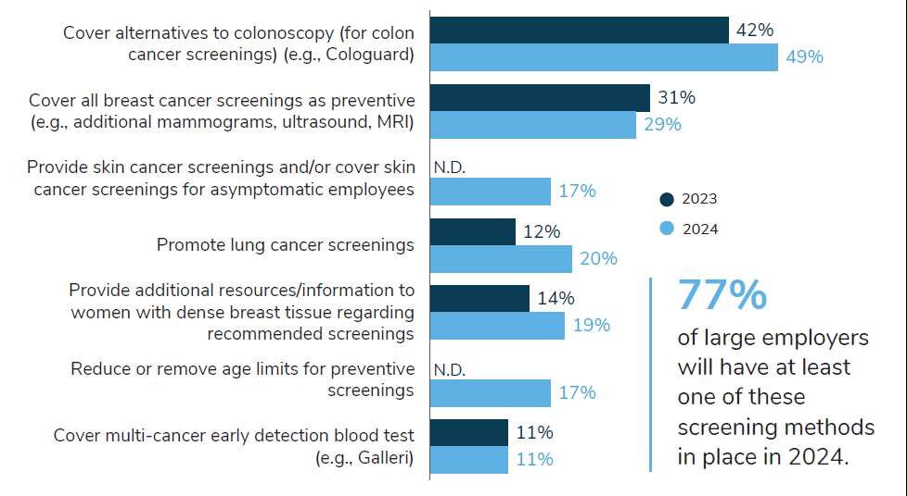
Cancer Screenings
41%
of employers are anticipating more late-stage cancers in their population due to delayed screenings
Action Items
Notes:
One of the best ways at a population level that employers can take action is in screening and early detection. Seems like a “so what” but there are additional benefit designs and changes in cancer screenings that can be deployed.
This information on this slide is coming from Business Group on Health and their recently released 2024 Large Employer Health Care Strategy Survey:
41% of employers are anticipating more late-stage cancer diagnoses due to delayed screenings and simply more complications or poorer outcomes due to care not received.
—a lingering effect of the pandemic, SDOH risks and other factors
(Choose a few of the screening actions that might address your client’s population needs or pain points—or use the below:)
We’re seeing an uptick in education for Lung cancer screenings (in the form of a CXR). This is good news because we are seeing:
An increase in lung cancer for never smokers- currently about 20% and is higher in women
Pollution, climate change also may increase lung cancer rates in the future and will increase in screening importance
A new option that 17% of clients are implementing in 2024, is to remove age limits for preventive screenings
We’re not sure what this will look like but it will be interesting to watch and see if screening rates are improving and what impact on cost, if any, it has to employers
Employers recognize that early detection can save costs—and lives…We have a new diagnostic test on the market (multi-early cancer detection) that deserves our attention
Consultants:
When sharing this slide with a client, if possible, know the client’s current preventive screening rates, pain points and trend trajectory prior to discussing options in your strategy discussion.
Preventive screening costs can be a barrier. Several of the above actions are removing additional cost barriers to increase engagement in cancer screenings.
A May 2023 study by ACS of cancer survivors showed (Survivor Views | American Cancer Society Cancer Action Network (fightcancer.org)):
A majority (58%) of cancer patients and survivors say they would be less likely to remain current with their recommended preventive care if it came with a cost, according to a new survey by the American Cancer Society Cancer Action Network (ACS CAN).
Over half (53%) of those surveyed quantified the cost that would present such a barrier at less than $200, with more than a quarter (28%) marking their threshold at $100.

Slide 20
2027 Renewal
Notes:
7 –Divider Slide

Slide 21
2027 Solutions
Renewal Marketing
UHC/Surest – Carrier March Board Meeting
Direct Primary Care – April Board Meeting
Long Term Care Implementation 4/1
Contributions Strategies
Question from last board meeting: Spousal surcharge impact – $100 per month if access to other employer coverage. 229 current spouses. Surcharge estimate: 15% to other coverage / 15% to pay surcharge

Slide 22
2027 Ancillary Renewal Status
Line of Coverage | Carrier/ Vendor | EE/ER Paid | Status | Recommendation
Dental | Delta Dental | EE/ER | Rate Pass through 1/1/2028 | Renew with Delta Dental
Vision | VSP | EE/ER | Up for Renewal 1/1/2027 | TBD
Basic Life and AD&D | Standard | ER | Up for Renewal 1/1/2027 | Go to Market
Voluntary Life and AD&D | Standard | EE | Up for Renewal 1/1/2027 | Go to Market
Short Term Disability | Standard | EE/ER | Up for Renewal 1/1/2027 | Go to Market
Long Term Disability | Standard | EE/ER | Up for Renewal 1/1/2027 | Go to Market
Critical Illness | VOYA | EE | Rate Pass | Go to Market
Hospital Indemnity | VOYA | EE | Rate Pass | Go to Market
Accident | VOYA | EE | Rate Pass | Go to Market
Notes:
Marketing Life/DI along with Worksite will maximize bundled savings opportunities
Notes:
22-20[CY] Renewal Recap
Responsible to complete: GSC/CST
Source: Current year Final Sold documents
Notes: GSC to complete first 5 columns of table; CST to complete Highlights column and any text outside table

Slide 23
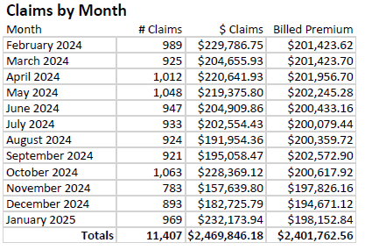
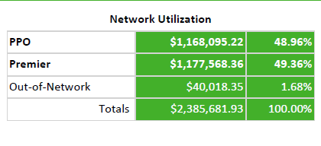
Dental Experience
2025 Claims & Enrollment
Prior Year OON Spend $55K
Current Period Loss Ratio: 102%

Slide 24
Renewal Timeline – OKHEEI
Activity | Target Date
Pre-Renewal Strategy Meetings | January & February
Census Request Due Date | February 1st
Expected Renewal Receipt from Incumbent Carrier | March 20th
Initial Renewal Meeting | April Board Meeting
Renewal Presentation | May Board Meeting
Renewal Decisions/College Contributions Due | July 1st
Annual Open Enrollment (Allows for 2-week OE and Thanksgiving) | Sept/October
OE Elections Due to Carriers | November 15th
Renewal Effective Date | January 1, 2027
Renewal Timeline above is set to ensure the best experience for employers and employees. Timeline may adjust due to benefit administration system requirements, holidays, or to allow for a transition to new carriers.

Slide 25
General Disclaimers
Coverage Disclaimer
This proposal is an outline of the coverages proposed by the carrier(s) based upon the information provided by your company. It does not include all the terms, coverages, exclusions, limitations, and conditions of the actual contract language. See the policies and contracts for actual language. This proposal is not a contract and offers no contractual obligation on behalf of GBS. Policy forms for your reference will be made available upon request.
Renewal / Financial Disclaimer
This analysis is for illustrative purposes only, and is not a proposal for coverage or a guarantee of future expenses, claims costs, managed care savings, etc. There are many variables that can affect future health care costs including utilization patterns, catastrophic claims, changes in plan design, health care trend increases, etc. This analysis does not amend, extend, or alter the coverage provided by the actual insurance policies and contracts. See your policy or contact us for specific information or further details in this regard.
Legal
The intent of this analysis is to provide you with general information regarding the status of, and/or potential concerns related to, your current employee benefits environment. It should not be construed as, nor is it intended to provide, legal advice. Laws may be complex and subject to change. This information is based on current interpretation of the law and is not guaranteed. Questions regarding specific issues should be addressed by legal counsel who specializes in this practice area.
Notes:
25-General Disclaimers
Responsible to complete: N/A, exists in template
Source: Gallagher One
Notes: CST to confirm that disclaimer language matches current Professional Standards disclaimer language

Slide 26

Thank you!
Notes:
26-Thank you!
Responsible to complete: GSC
Notes: CST to provide instructions

