Slide 1
OKHEEI Board Meeting
Daniel Somers, Pete Towne, Summer Brown, and Harmony Holloway
January 7th, 2026
Notes:
5-Option 2 Cover Page

Slide 2
Agenda
Renewal & Open Enrollment Timeline
Long Term Care
Plan Performance
Strategic Initiatives
Notes:
Introductions- add
Renewal summary service review
Financial update
Industry updates

Slide 3
Plan Performance
Notes:
3-Divider slide
Responsible to complete: GSC

Slide 4
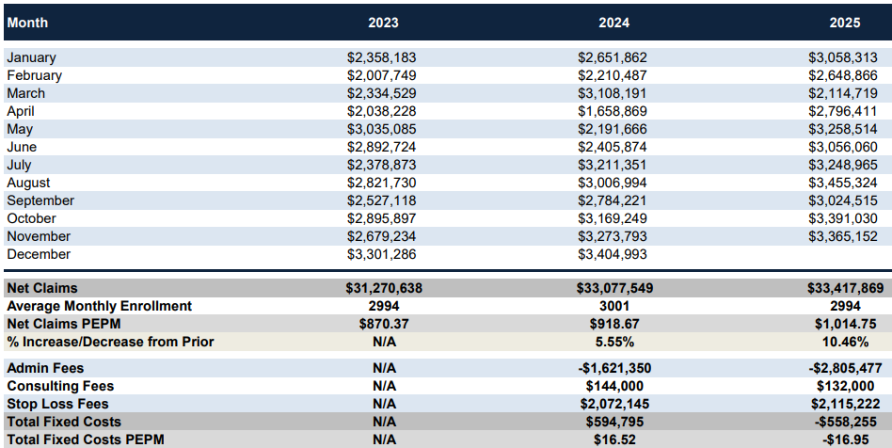

Financial Monitoring Report
2025
Since 2023….
Net Med & Rx has increased from $870 PEPM to $1,015 PEPM
Zero Card has decreased from $101 PEPM to $96 PEPM
Fixed Costs decreased from $27 PEPM to Negative ($17) PEPM

Slide 5
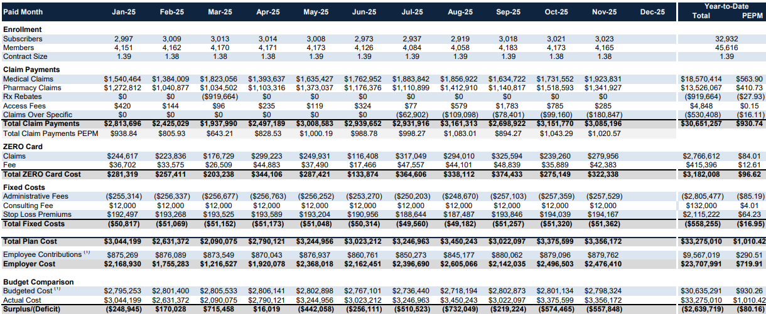
Financial Monitoring Report
2025 – All Membership
Budget does not include $1,000,000 assessment
Enrollment for January 2026 is 3,017
Active Employees are over budget by ($75.93 PEPM)
Early Retirees are over budget by ($578.05 PEPM)

Slide 6
Year over Year Large Claim Trend
2017 – November 2025
24
23
25
14
12
14
12
11
9
Note: Blue boxes represent # of members that exceeded $150k in claims
2023 – Above members represent $5,567,852 in paid claims
2024 – Above members represent $6,829,824 in paid claims
2025 – Above members represent $6,267,284 in paid claims
Notes:
Sub in oncology focus if more relevant

Slide 7
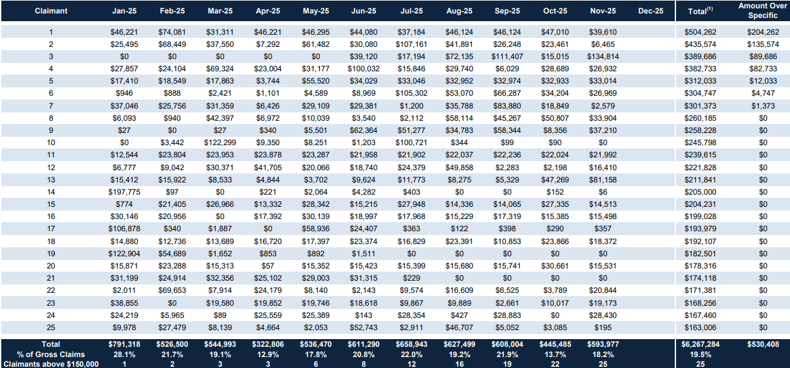
Large Claimants
2025
Termed
Termed
Termed
Termed
11 of the 25 claimants above are cancer diagnosis
18 of the 25 are enrolled in Plan B
Notes:
Sub in oncology focus if more relevant

Slide 8
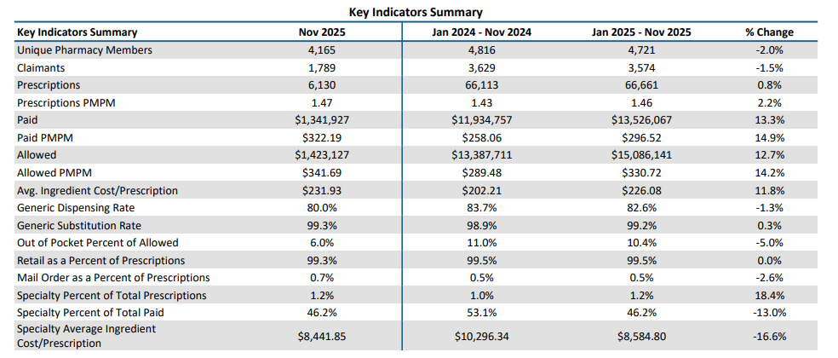
Financial Monitoring Report
2024 vs 2025
Paid Per Member Per Month has increased 14.9%
Average Ingredient Cost per Script has increased 10.4% (Trend is at 13%)
Specialty has decreased 16.6% - Flex Access program is Working!

Slide 9
2026 Renewal
Renewal Decisions
Notes:
9-Divider slide
Responsible to complete: GSC

Slide 10
2026 RFP
Renewal Marketing
Medical Plan Alternative Providers
Overall Plan Increase of 9%
Gallagher Benefits marketed to 18 self-funded TPA’s, networks and stop loss carriers. BCBS and Surest most competitive in benefits and pricing. Surest was a 6.4% increase over current.
  Reminder - Some markets will not allow “firm and final” due to early timing requirements of renewal.
Moved to Blue Advantage Plans for a 4.4% savings ($1.5 Million)
Added Plan D with access to Blue Options (Mirrored Plan C Benefits). 216 Employee’s enrolled in Plan D at open enrollment.
Dental Plan – Coming out of rate guarantee. Received 2-year rate guarantee 26-27
  Preventive Plan Loss Ratio – 111% - 11% increase - $2.02 on ee only rate per month
  Low Plan Loss Ratio – 112% - 12% increase - $4.44 on ee only rate per month
  High Plan Loss Ratio – 132% - 20% increase - $10.06 on ee only rate per month
Vision Plan – Rate Guarantee
Life & Disability – The Standard
Basic Life – Renewal step increase from $.14 to $.155.
Voluntary Life, STD, and LTD – Rate Pass w/ 2-year rate guarantee 25-26

Slide 11
Enrollment Breakdown
 | 2023 | 2024 | 2025 | 2026
Total Enrollment | 2991 | 2999 | 3023 | 3017
Plan A ($750) | 27% | 23% (703 ee’s) | 7% (215 ee’s) This shift caused loss in budget | 6% (174 ee’s)
Plan B ($1,250) | 39% | 42% (1,265 ee’s) | 56% (1,696 ee’s) | 46% (1,390 ee’s)
Plan C (2,000) | 32% | 32% (961 ee’s) | 34% (1,033 ee’s) | 38% (1,158 ee’s)
Plan D (2,000) | NA | NA | NA | 7% (225 ee’s)
Plan F (HSA $3,500) | 2% | 3% (70 ee’s) | 3% (79 ee’s) | 3% (70 ee’s)

Slide 12
2027 Renewal
Notes:
7 –Divider Slide

Slide 13
Renewal Timeline – OKHEEI
Activity | Target Date
Pre-Renewal Strategy Meetings | January & February
Census Request Due Date | February 1st
Expected Renewal Receipt from Incumbent Carrier | March 15th
Renewal Presentation | May 20th
Renewal Decisions/College Contributions Due | May 31st
Annual Open Enrollment (Allows for 2-week OE and Thanksgiving) | Sept/October
OE Elections Due to Carriers | November 15th
Renewal Effective Date | January 1, 2026
Renewal Timeline above is set to ensure the best experience for employers and employees. Timeline may adjust due to benefit administration system requirements, holidays, or to allow for a transition to new carriers.

Slide 14
2027 Solutions
Renewal Marketing
Renewal Timing / Decision Discussion
Medical Plan Alternative Providers
UHC/Surest – Carrier Presentation?
Zero Card Replacement
Contributions Strategies
Pre-65 Funding Strategies

Slide 15
2027 Addt. Strategic Solutions
Sustainability and Proactive Plan Management
Separate Rx Deductible
Gallagher evaluated adding separate deductible on Rx plan to mimic State Plan. This would erode value and add significant cost back to the member. Recommend OKHEEI does not add separate Rx deductible
Deductibles and Office Visit Copays
  Gallagher evaluated increase in office visit copays and deductible. Neither would have significant impact to overall plan cost. Recommendation to leave “as is”
  Employee Contributions
  OKHEEI allows for each college to independently set employee contributions. Employers use employee contributions to offset total plan expense. Considering the plan enrollment distribution, Gallagher recommends a strategic look into the overall design of the contribution strategy.

Slide 16
2026 LTC Kickoff
Coming 4/1
Notes:
7 –Divider Slide

Slide 17
General Disclaimers
Coverage Disclaimer
This proposal is an outline of the coverages proposed by the carrier(s) based upon the information provided by your company. It does not include all the terms, coverages, exclusions, limitations, and conditions of the actual contract language. See the policies and contracts for actual language. This proposal is not a contract and offers no contractual obligation on behalf of GBS. Policy forms for your reference will be made available upon request.
Renewal / Financial Disclaimer
This analysis is for illustrative purposes only, and is not a proposal for coverage or a guarantee of future expenses, claims costs, managed care savings, etc. There are many variables that can affect future health care costs including utilization patterns, catastrophic claims, changes in plan design, health care trend increases, etc. This analysis does not amend, extend, or alter the coverage provided by the actual insurance policies and contracts. See your policy or contact us for specific information or further details in this regard.
Legal
The intent of this analysis is to provide you with general information regarding the status of, and/or potential concerns related to, your current employee benefits environment. It should not be construed as, nor is it intended to provide, legal advice. Laws may be complex and subject to change. This information is based on current interpretation of the law and is not guaranteed. Questions regarding specific issues should be addressed by legal counsel who specializes in this practice area.
Notes:
17-General Disclaimers
Responsible to complete: N/A, exists in template
Source: Gallagher One
Notes: CST to confirm that disclaimer language matches current BOSS disclaimer language

Slide 18
Thank you!

