Slide 1
Solving the “Triple Aim”
Better Health - Better Healthcare - Lower Costs
presentation to
Oklahoma Higher Education Employee Insurance Group
August 4, 2016

Slide 2
Agenda
Introduction and background
Description of the MedEncentive Program
How the MedEncentive Program works
Independent studies and industry validation
State of Oklahoma-MedEncentive 3-year pilot
Implementation

Slide 3
The State of Oklahoma Mutual Accountability Program Pilot

Slide 4
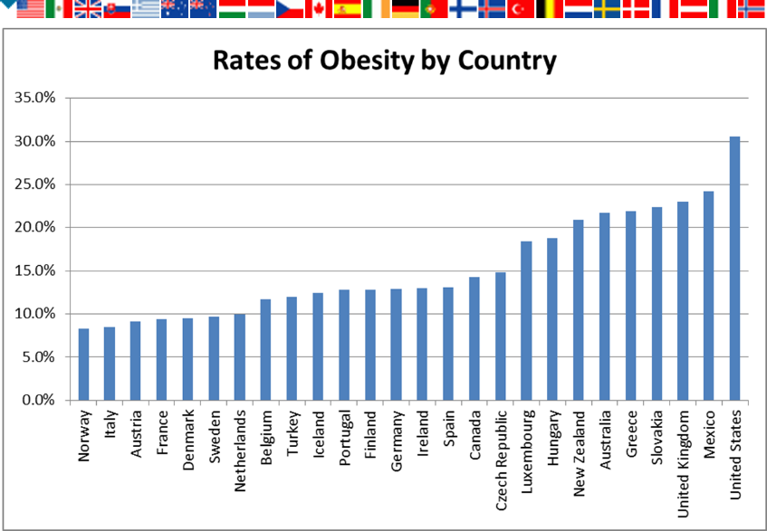
Crisis One
Our country needs to be healthier...

Slide 5
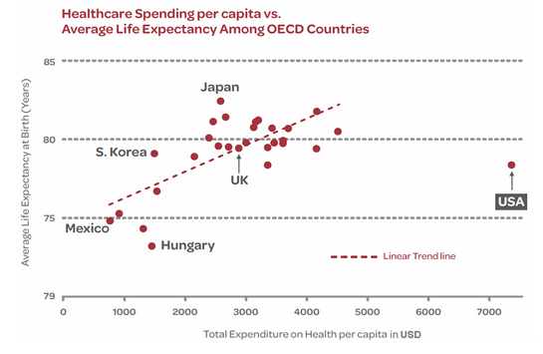
Crisis Two
Our country needs better value from its healthcare delivery system...

Slide 6
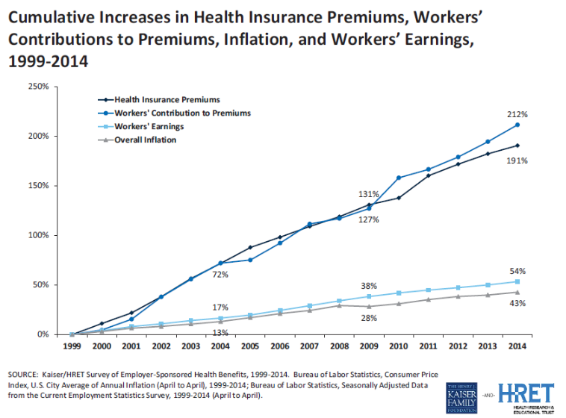
Crisis Three
Our country must contain healthcare expenditures...

Slide 7
MedEncentive – The Triple Aim Solution
The “Three-Part or Triple Aim” is defined as:
Simultaneously
improving health and;
improving health care;
in a manner that leads to lower overall costs and a return on investment in a normally distributed population
Heretofore, the Three-Part Aim has never been achieved...

Slide 8
The Obvious Solution to These Challenges
Motivate Better Human Behavior
By combining human factors and systems engineering with web-technology and an array of social sciences…
…MedEncentive has developed a patented incentive system that has been independently validated to improve human behavior in a manner that solves the “three-part aim.”

Slide 9
The MedEncentive Program’s Scientific Basis
Health literacy is the single strongest determinant of life expectancy and how much health care a person will consume in a lifetime.

Slide 10
Poor doctor-patient communications…
A battery of studies have determined:
Doctors interrupt patients within the first 23 seconds
15% of patients fully understand their doctor
50% of patients comply with doctors’ orders
Causes misdiagnosis, inferior clinical outcomes, malpractice, and higher costs

Slide 11
What you don’t know can kill you… and can also bankrupt you
Northwestern and Emory researchers found that health literacy is directly correlated to life expectancy
Multiple studies compiled by the U.S. government found that the health illiterate costs 4 times as much
When people know the “how” and “why,” they are more em-powered and motivated to comply with recommended treat-ments and adopt healthy behaviors. Behavioral science calls this the:
Knowledge-Adherence Response
This helps explain why the MedEncentive Program’s “information therapy” feature is so important.

Slide 12
Mutual Accountability Program’s Scientific Basis
The Hawthorne effect is a psychological phenomenon that produces an improvement in human behavior or performance as a result of increased attention from superiors or persons in positions of authority and trust.
In all cases, observed individuals behave or perform better than unsupervised individuals for a limited time if they suspect or know about the observation.

Slide 13
Confirming the Hawthorne Effect in the doctor-patient relationship
Doctor-Patient Relationship Influences Patient Engagement
Release Date: November 29, 2011 | By Valerie DeBenedette, Contributing Writer Research Source: Center for Advancing Health
Researchers asked 8,140 people in the U.S. with chronic illnesses about their experiences with their physicians, as well as about their socioeconomic status, overall health and how they make use of health services.
Behavioral science refers to this phenomenon as the...
Authority-Adherence (Obedience) Response
...which is analogous to the Hawthorne Effect
Patients who perceived their physicians were involved in their care were more likely to monitor their blood pressure, exercise five days a week and adhere to medication regimens, among other healthy behaviors.
This helps explain why the MedEncentive Program’s “mutual accountability” feature is so important.

Slide 14
Harnessing the power of three motivators in a systematic manner is the key to improving human behaviors and controlling cost
Program is effective because it:
Uses “precision-guided financial rewards” to...
Invoke the Hawthorne Effect and customer psychology by tapping into the doctor-patient relationship to cause a state of “mutual accountability”
Advance patient health literacy with what is called “information therapy”
© 2016 MedEncentive, LLC. All Rights Reserved

Slide 15
The Mutual Accountability Program works because...
Patients don’t want their doctors to think they are health illiterate and non-compliant
Doctors don’t want their patients to think they practice substandard care
Health literacy and the Hawthorne Effect causes an improvement in medication adherence and other types of patient compliance
Service and image psychology causes healthcare providers to improve their performance
Hospitalizations and emergency room visits decline
Patient accountability relieves some degree of defensive medicine
Cost are contained to the point a return on investment is realized by the plan sponsor

Slide 16
Solving the “Triple Aim”
Better Health - Better Healthcare - Lower Costs
How the Mutual Accountability
Program Works

Slide 17
How the Mutual Accountability Program Works
Plan sponsors (health insurers, employers and governments) underwrite the Program’s costs, arrange to have eligibility and claims transmitted to MedEncentive, pay rewards transmitted by MedEncentive, and then pocket the savings
Doctors and patients earn financial rewards immediately after each office visit by voluntarily accessing MedEncentive’s website to complete an information therapy (Ix®) session
© 2016 MedEncentive, LLC. All Rights Reserved

Slide 18
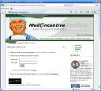
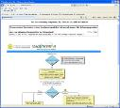
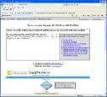
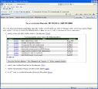
How the Mutual Accountability Program Works - Physicians
Physicians are compensated with each office visit involving a MAP beneficiary for accessing the MAP website to:
Enter the patient’s name and diagnosis or respond to an email notice from MedEncentive;
Declare adherence or provide reason for non-adherence to an evidence-based treatment guideline related to the patient’s diagnosis;
Prescribe educational material from a list of articles relevant to the patient’s diagnosis as “homework” (information therapy - Ix®)
Agree to allow the patient to confirm the physician’s adherence to the guideline and educational material or concur with the physician’s reason for non-adherence;
Agree to monitor the patient’s education and declaration of adherence through the Program.
Takes less than a minute, making participation in the Program one of the most lucrative services rendered in clinic.
© 2016 MedEncentive, LLC. All Rights Reserved

Slide 19
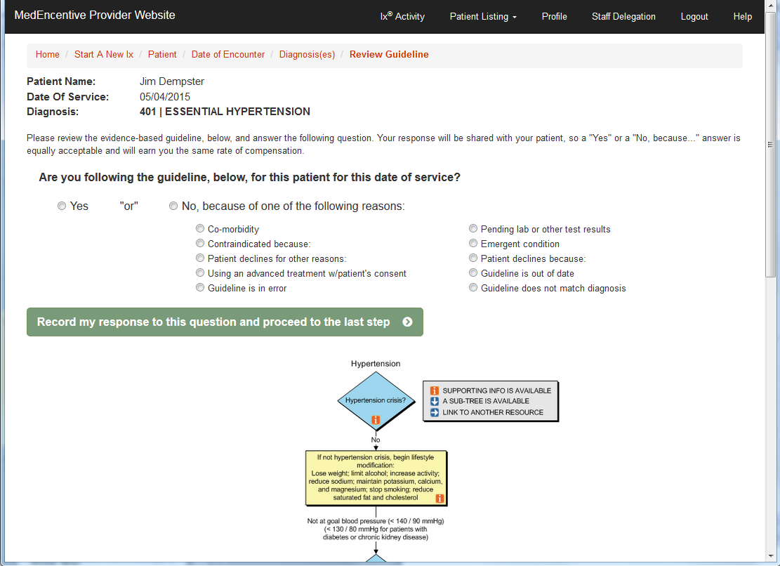
The Information Therapy (Ix) Program Basics ▪ First step – Tell the patient whether or not an evidence-based guideline fits
Anti-cookbook medicine feature
© 2016 MedEncentive, LLC. All Rights Reserved

Slide 20
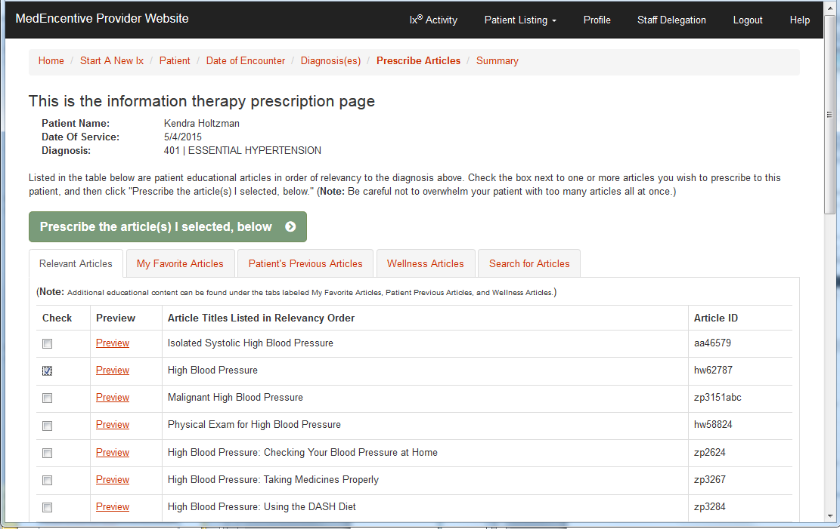
The Information Therapy (Ix) Program Basics ▪ Second step – Prescribe information therapy to the patient as “homework”
Educational articles listed in relevancy to patient’s diagnosis
© 2016 MedEncentive, LLC. All Rights Reserved

Slide 21
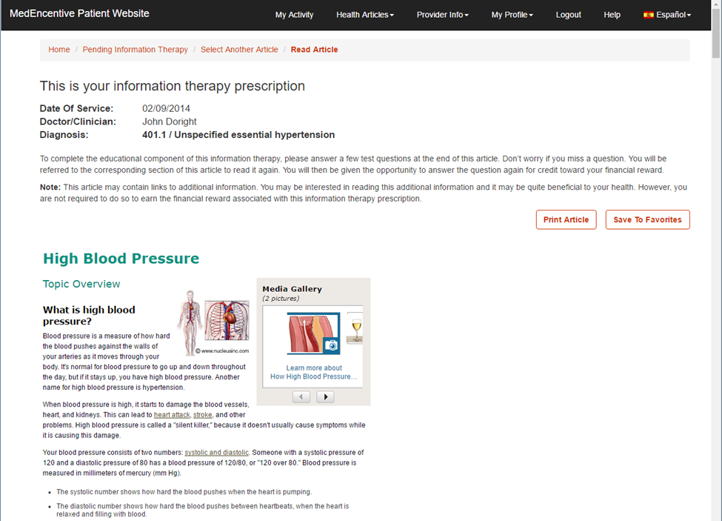
How the Mutual Accountability Program Works - Patients
Patients earn back some or all of their office visit co-payment (typically $15 to $25) by accessing the MAP website, in response to an information therapy prescription letter sent to their home after each office visit, to:
Read the prescribed educational article relevant to their diagnosis;
Demonstrate their understanding of the article by passing an open-book test and/or declaring their comprehension;
Declare their adherence or provide a reason for non-adherence to the article’s recommendations;
Agree to allow their physician to review their comprehension and declaration of adherence or reason for non-adherence;
Rate their physician’s performance against what they’ve read and the physician’s declaration of adherence or reason for non-adherence to the recommended treatments.
© 2016 MedEncentive, LLC. All Rights Reserved

Slide 22
Solving the “Triple Aim”
Better Health - Better Healthcare - Lower Costs
Measuring How Well the Program Works
Trial results and independent analyses

Slide 23
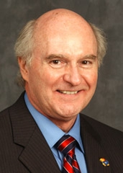
MedEncentive’s Estimated Impacts on Employer’s Costs of Insurance and Individual Healthcare Costs: a Preliminary Case Study
Douglas D Bradham, Dr.P.H., Kansas Health Foundation Distinguished Professor of Public Health – Health Economist
Nikki Keene, MA, MPH, PhD Candidate – Behavioral Psychologist
Traci Hart, PhD , Research Assistant Professor – Human Factors Psychologist
Phillip Twumasi-Ankrah, PhD, Assistant Professor - Biostatistician
Amy Chesser, PhD, Research Assistant Professor – Healthcare Communications
Department of Preventive Medicine and Public Health
University of Kansas, School of Medicine – Wichita
Notes:
23

Slide 24
The Oklahoma Trial
Over a four year period after implementation, the City of Duncan employee health plan realized a savings of between $3.1 and $17.7 for each $1 invested in the MedEncentive Program.
(Validated non-catastrophic and total claims expenditure against average trend over 4 years)

Slide 25
The Kansas Trial
In the 2½ years after the Wichita Clinic implemented the MedEncentive Program:
Office visits increased 13%
Medication adherence reported at 94%
Hospitalizations decreased 55%
Refer to University of Kansas School of Medicine research abstract and poster (following slide)

Slide 26
The Washington Trial
The Loomis Company Analysis of MedEncentive at Lourdes Health Network
Tom Forsbeg, The Loomis Company

Slide 27
Wyomissing, Pennsylvania-based award winning insurance services company
Founded in 1955, family-owned and operated
Offices located across the country
Third party administrator for Lourdes Health Network

Slide 28
Located in Pasco, Washington
Founded in 1916
Faith-based hospital system
1,100 health plan members
Unionized workforce
Escalating healthcare costs prior to adopting the MedEncentive Program in 2008
An Ascension Health facility

Slide 29
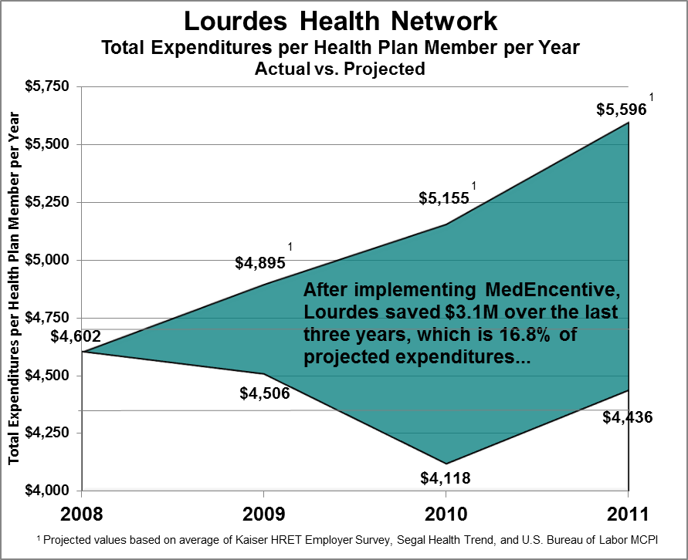
Over $3M savings in last three years

Slide 30
Three year savings vs. MedEncentive program investment = 12:1 ROI
Three Year Savings vs. Projection¹
$3,125,697
Total Investment $257,552
1
¹ Projected values based on average of Kaiser HRET Employer Survey, Segal Health Trend, and U.S. Bureau of Labor MCPI

Slide 31
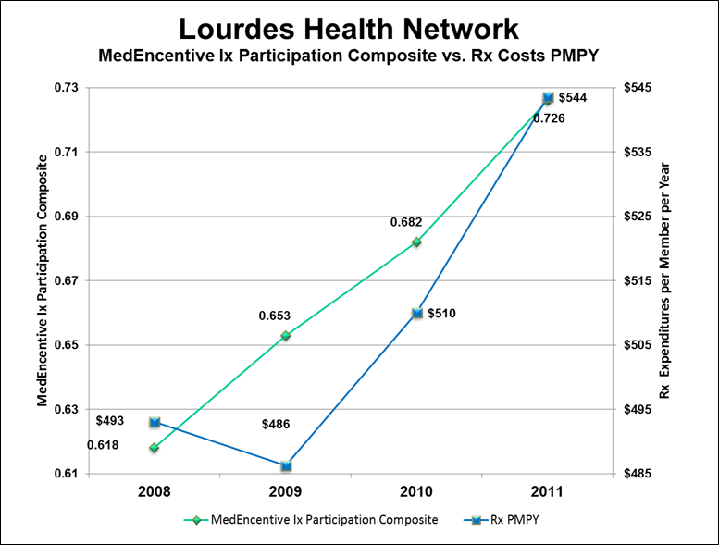
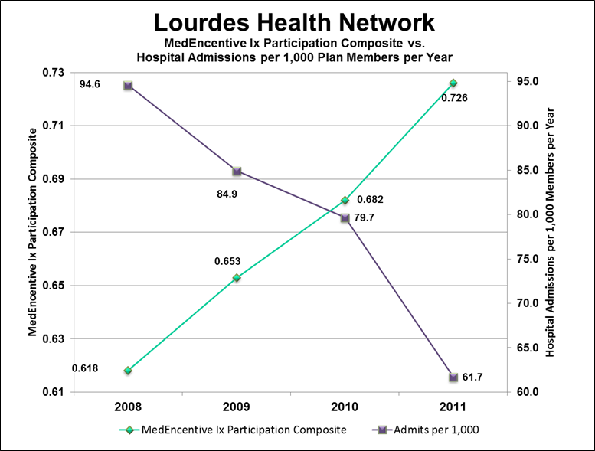
Causality Question: How can the ROI be attributed to MedEncentive?
Answer: As participation in MedEncentive went up, health literacy and medication adherence increased, while hospitalizations declined, which produced the savings...

Slide 32
What employers say...
“While we’ve saved millions of dollars over the years with our wellness program and MedEncentive, the most important attributes about MedEncentive are how much our employees appreciate the program, how simple it is to maintain and how very little administrative support is required. It has been a win for our organization, our employees and our physicians.”
Shannon Douglas
Compensation/Benefits Manager | Human Resources
Lourdes Health Network
Pasco Washington

Slide 33
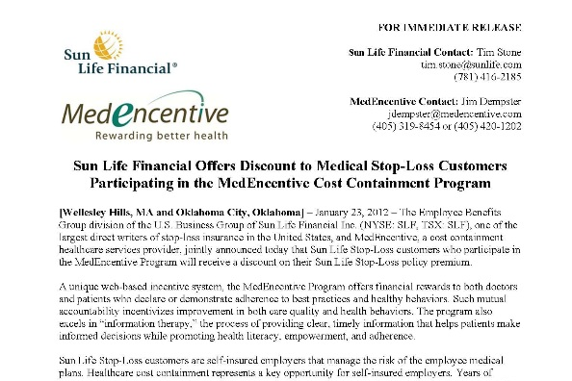
Industry Validation
“After analyzing the results from MedEncentive’s trials, we are impressed with the firm’s approach to mitigating healthcare costs by promoting health.
Because of our confidence in the MedEncentive Program, we will provide a discount on Sun Life Stop-Loss premium to customers who participate in the program.”
Scott Beliveau, Sun Life Financial Stop-Loss Vice President
No stop-loss carrier has ever publically endorsed a health improvement program. Now three of the top-ten have...
...Sun Life, AIG and IHC Risk Solutions.
© 2013 MedEncentive, LLC. All Rights Reserved

Slide 34
The State of Oklahoma Mutual Accountability Program Pilot

Slide 35
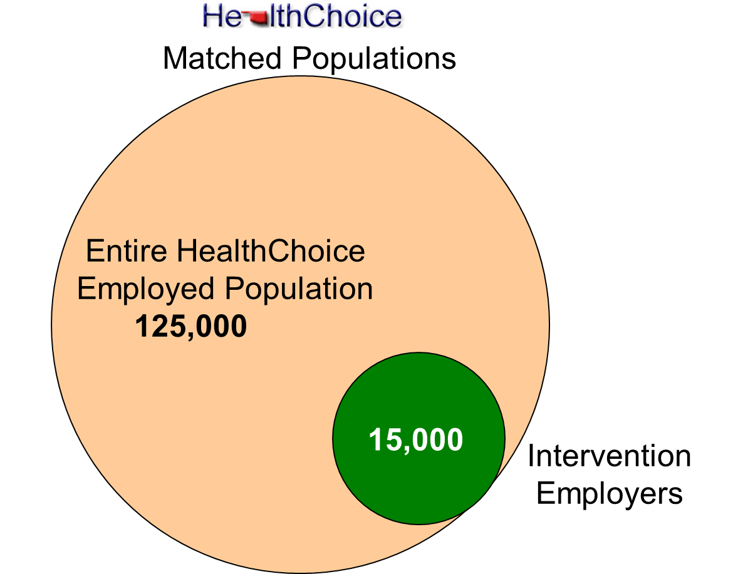
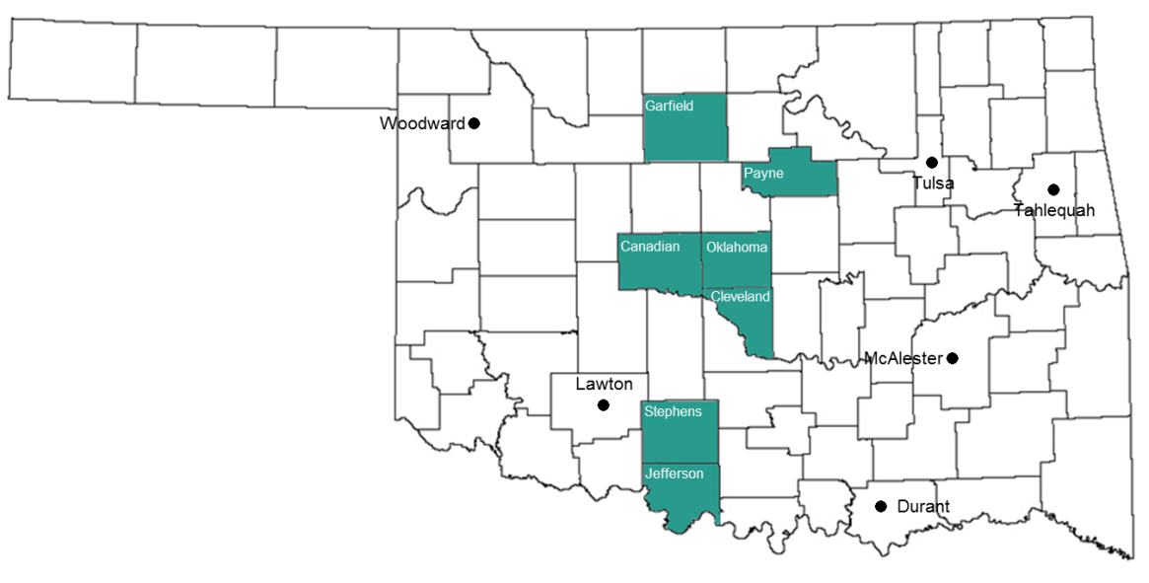
The Mutual Accountability Program (“MAP”) Pilot Project
A three-year pilot involving a cohort study using an appropriate scientific methods to principally compare per-capita costs of an intervention group covered by the MAP, comprised of at least 15,000 HealthChoice beneficiaries of schools districts, State agencies and local governments concentrated in seven counties, against a control group consisting of the remaining HealthChoice enroll-ment of approximately 110,000 public sector employees and their families.

Slide 36
The State of Oklahoma and MedEncentive
are involved in the largest health improvement/ cost containment (Three-Part Aim) experiment ever attempted in the U.S.
MUTUAL ACCOUNTABILITY PROGRAM PILOT

Slide 37
Solving the “Triple Aim”
Better Health - Better Healthcare - Lower Costs
State of Oklahoma Pilot
Patient Activity

Slide 38
Metrics that predict success
Based on our 10 years of experience, the strongest determinant of a return on investment is the Patient Success Rate¹
In our previous trials, a Patient Success Rate of 55% or greater produced a ROI in each instance
¹ Patient Success Rate = the total number of information therapy sessions ÷ the total number of office visits incurred by the covered population

Slide 39
Patient Success Rate by Quarter

Slide 40
Oklahoma Employers Annual Member Activity By Employer
Customer | Total Patient Ix Opportunities | Total Patient Ix Successes | Total Patient Ix Misses | Total Patient Ix Successes and Misses | Patient Success Rate
STEPHENS COUNTY RWD & SWM #1 | 12 | 12 | 0 | 12 | 100.00%
STEPHENS COUNTY RWD & SWM #3 | 4 | 4 | 0 | 4 | 100.00%
TOWN OF NORTH ENID | 21 | 20 | 1 | 21 | 95.24%
GARFIELD COUNTY RWD #5 | 19 | 18 | 1 | 19 | 94.74%
NORMAN HOUSING AUTHORITY | 110 | 92 | 18 | 110 | 83.64%
OKLAHOMA DEPARTMENT OF CAREER & TECHNOLOGY EDUCATI | 2,264 | 1,805 | 459 | 2,264 | 79.73%
OKLAHOMA STATE BUREAU OF INVESTIGATION | 1,813 | 1,413 | 400 | 1,813 | 77.94%
STILLWATER HOUSING AUTHORITY | 86 | 67 | 19 | 86 | 77.91%
OFFICE OF THE LIEUTENANT GOVERNOR | 47 | 35 | 12 | 47 | 74.47%
CUSHING PUBLIC SCHOOLS | 858 | 634 | 224 | 858 | 73.89%
DEPARTMENT OF COMMERCE | 522 | 380 | 142 | 522 | 72.80%
STILLWATER PUBLIC SCHOOLS | 3,477 | 2,516 | 961 | 3,477 | 72.36%
Stillwater Medical Center | 6,039 | 4,187 | 1,852 | 6,039 | 69.33%
MOORE-NORMAN TECHNOLOGY CENTER | 1,019 | 701 | 318 | 1,019 | 68.79%
JEFFERSON COUNTY | 229 | 157 | 72 | 229 | 68.56%
DEPARTMENT OF AGRICULTURE | 2,151 | 1,454 | 697 | 2,151 | 67.60%
MUSTANG PUBLIC SCHOOLS | 3,660 | 2,468 | 1,192 | 3,660 | 67.43%
City of Yukon | 1,044 | 703 | 341 | 1,044 | 67.34%
NORMAN PUBLIC SCHOOLS | 7,711 | 5,088 | 2,623 | 7,711 | 65.98%
PERKINS-TRYON PUBLIC SCHOOLS | 605 | 397 | 208 | 605 | 65.62%
STEPHENS COUNTY | 710 | 462 | 248 | 710 | 65.07%
J D MCCARTY CENTER | 1,638 | 1,065 | 573 | 1,638 | 65.02%
OKLAHOMA INSURANCE DEPT | 535 | 346 | 189 | 535 | 64.67%
OKLAHOMA MILITARY DEPARTMENT | 1,370 | 883 | 487 | 1,370 | 64.45%
OFFICE OF MANAGEMENT & ENTERPRISE SERVICES | 7,348 | 4,708 | 2,640 | 7,348 | 64.07%
OKLAHOMA HEALTH CARE AUTHORITY | 3,104 | 1,981 | 1,123 | 3,104 | 63.82%
STEPHENS COUNTY RWD #5 | 30 | 19 | 11 | 30 | 63.33%
All Customers | 79,778 | 50,476 | 29,301 | 79,778 | 63.27%
DUNCAN PUBLIC SCHOOLS | 2,158 | 1,361 | 797 | 2,158 | 63.07%
OKLAHOMA CENTER FOR ADVANCEMENT OF SCIENCE & TECHN | 88 | 55 | 33 | 88 | 62.50%
YUKON PUBLIC SCHOOLS | 2,373 | 1,483 | 890 | 2,373 | 62.49%
CLEVELAND COUNTY | 1,606 | 986 | 620 | 1,606 | 61.39%
ENID PUBLIC SCHOOLS | 4,392 | 2,632 | 1,760 | 4,392 | 59.93%
OKLAHOMA HISTORICAL SOCIETY | 618 | 368 | 249 | 617 | 59.64%
CANADIAN COUNTY | 1,105 | 658 | 447 | 1,105 | 59.55%
OKLAHOMA CORPORATION COMMISSION | 2,631 | 1,558 | 1,073 | 2,631 | 59.22%
OKLAHOMA CITY HOUSING AUTHORITY | 599 | 353 | 246 | 599 | 58.93%
OKLAHOMA TOURISM & RECREATION | 2,047 | 1,198 | 849 | 2,047 | 58.52%
GARFIELD COUNTY RWD #6 | 25 | 14 | 11 | 25 | 56.00%
Goal |  |  |  |  | 55.00%
CITY OF RUSH SPRINGS | 38 | 20 | 18 | 38 | 52.63%
CITY OF WAURIKA | 57 | 30 | 27 | 57 | 52.63%
OKLAHOMA CITY PUBLIC SCHOOLS | 15,353 | 8,019 | 7,334 | 15,353 | 52.23%
OKLAHOMA EDUCATIONAL TELEVISION AUTHORITY | 253 | 126 | 127 | 253 | 49.80%
CITY OF GARBER | 9 | 0 | 9 | 9 | 0.00%

Slide 41
2015 Member Comments
In 2015, Plan Members offered
3,008
voluntary comments through the Program

Slide 42
2015 Member Comments
Testimonial to complaint ratio = 50:1

Slide 43
Lots of patient testimonials...
“This is great! I like the information and getting paid to take better care of myself is the BEST idea ever!”
Elayne
April 24, 2015
“This is a wonderful program. One of very few targeted to personalize my healthcare & physician relationship. I will continue to take advantage of this program as long as it is offered.”
Rita
May 2, 2015
“This program is easy to use! I have found the information relevant to my health care needs. The articles are easy to read and the questionnaire is quick to fill out. I appreciate this opportunity to earn some cash!”
Rhett
May 25, 2015

Slide 44
Hawthorne Effect – Doctors’ Influence on Patients’ Compliance
On a scale from 1 to 10, with 10 being the most, how important is it to you that your doctor is aware that you are trying to accomplish or are accomplishing health objectives?

Slide 45
Health Literacy – Impact of Program’s Information Therapy
On a scale of 1 to 5 (5 being the most), how helpful has this article’s information been to you in managing your disease or condition, or in maintaining your good health?

Slide 46
The Mutual Accountability Program saves lives…

Slide 47
Solving the “Triple Aim”
Better Health - Better Healthcare - Lower Costs
State of Oklahoma Pilot
Provider Activity

Slide 48
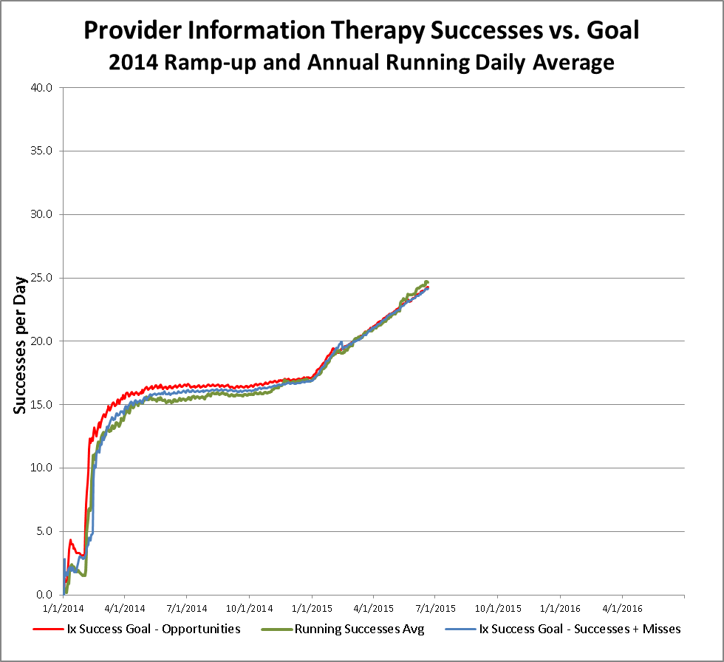
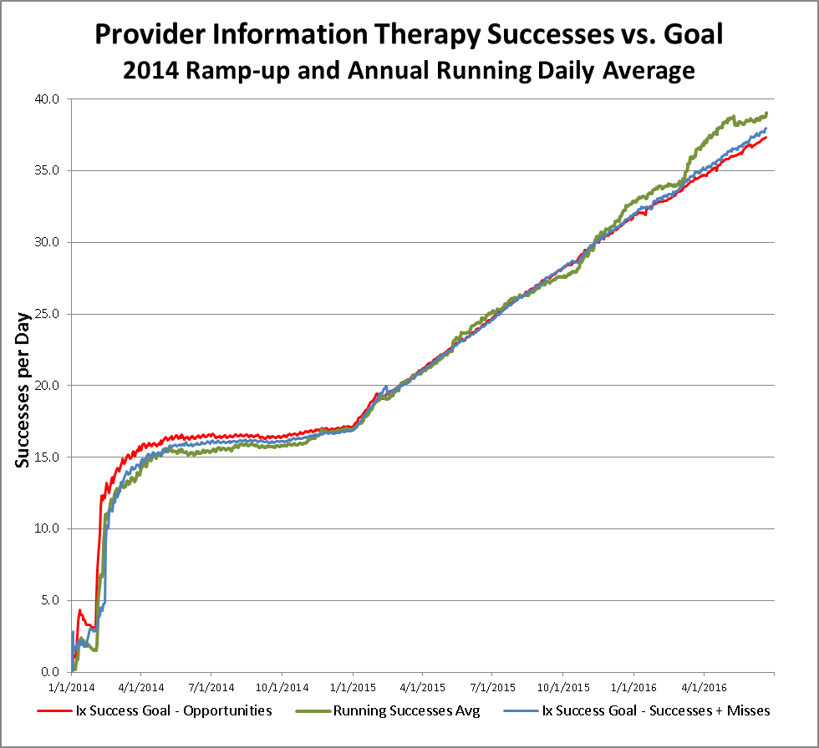
Actual Provider Successes vs. Goal

Slide 49
Mutual Accountability Program Provider Advocates
Provider Full Name | Specialty | City | State
Jennifer Acuna, PA | Physician Assistant | Oklahoma City | OK
Jerome L. Anderson, MD | Cardiovascular Diseases | Oklahoma City | OK
Randal Scott Baker, MD | General Surgery | Stillwater | OK
William F. Barnes, MD | Urology | Oklahoma City | OK
Douglas Wayne Brant, MD | Family Medicine | Bethany | OK
Jesse Ray Campbell, MD | Internal Medicine, Pediatrics | Edmond | OK
Craig Carson, MD | Rheumatology | Edmond | OK
Max G. Cates, MD | Family Medicine | Oklahoma City | OK
Mary Chambers, MD | Obstetrics & Gynecology | Norman | OK
Susan Chambers, MD | Obstetrics & Gynecology | Oklahoma City | OK
Stephen Connery, MD | Family Medicine | Norman | OK
Brian Ellis, MD | Pediatrics | Norman | OK
Glynda Fox, NP | Nurse Practitioner | Stillwater | OK
Emily Friedman, MD | Neurosurgery | Oklahoma City | OK
Susan Grandle, NP | Nurse Practitioner | Oklahoma City | OK
Alecia A. Hanes, MD | Pediatrics | Yukon | OK
Michael Hartwig, MD | Family Medicine | Perry | OK
Christopher Michael Herndon, MD | Family Medicine | Duncan | OK
Colin Hill, PA | Physician Assistant | Woodward | OK
Deborah Huff, MD | Obstetrics & Gynecology | Oklahoma City | OK
Russell Ingram, MD | Family Medicine | Bethany | OK
Mark Kowalski, MD | Orthopedic Surgery, Sports Medicine | Oklahoma City | OK

Slide 50
What physician leaders say...
“This is a unique tool to improve a critical component of health care - patient compliance”
Steve Connery, M.D.
Family Physician
President of the Norman Physician Hospital Organization
Norman, Oklahoma
“I have found the program useful in increasing patient engagement, and think ultimately will lead to better health outcomes. It is user friendly and minimally disruptive to my normal workflow.”
Jesse R. Campbell, M.D.
Internal Medicine, Pediatrics
Medical Director, Mercy Physician Group
Edmond, Oklahoma

Slide 51
Solving the “Triple Aim”
Better Health - Better Healthcare - Lower Costs
State of Oklahoma Pilot
Bottom-line ROI

Slide 52
MedEncentive has retained the Validation Institute to confirm our claims of healthcare cost containment efficacy
Not-for-profit joint venture of GE and Intel
Formed to establish truth in population health claims after the North Carolina patient-centered medical home fiasco
Involves industry watchdog, Al Lewis, who wrote book about falsifying results in the field of healthcare cost containment, entitled: Why Nobody Believes the Numbers”

Slide 53
State of Oklahoma MAP Pilot Preliminary Results Group covered by MAP 2.5% decline in total PMPY costs translated to $1.7 million savings and a 2.4:1 return on investment in the first year of the pilot

Slide 54
State of Oklahoma MAP Pilot Preliminary Results Group covered by MAP demonstrated a 10.5% greater decline in hospitalizations per 1,000 compared to the control group in the pilot’s first year

Slide 55
State of Oklahoma MAP Pilot Preliminary Results Group covered by MAP demonstrated a 4.7% greater decline in emergency room visits per 1,000 compared to the control group in the pilot’s first year

Slide 56
Solving the “Triple Aim”
Better Health - Better Healthcare - Lower Costs
Implementation Discussion

Slide 57
Costs and expected savings associated with the MedEncentive Program
Rule of thumb - $100 PMPY total program costs, includes:
rewards to plan members
medical providers compensation
MedEncentive’s $3.50 pmpm fee
Expect a 2:1 ROI, which means approximately $200 PMPY savings relative to a cohort or relative to projected trend

Slide 58
What’s included in MedEncentive’s fees and services...
An incentive system based on patented methods and research that has been proven effective at solving the Three-part Aim
Proprietary website applications available to doctors and patients 24/7
EBM provider treatment guidelines and Healthwise patient educational articles linked to patient diagnosis
Full system integration with plan administrators and medical intervention providers
Automated doctor and patient notifications and reminders (letter, email and fax)
On-going doctor and patient outreach/recruiting services
Physician advocates
24/7 bi-lingual, handicapped enabled call center for doctors and patients
Forms and postage
Reliable computing capacity, including cloud back-up and disaster recovery protocol
Complete quality assurance monitoring system
Full HIPAA compliancy and data security
Reporting, analysis, population health expertise, and on-going program upgrades

Slide 59
What employers say...
“We are very pleased with how easy the MedEncentive Program was to implement and how very little time is needed in support of this program. Our employees like the program and participation has reached over 65% within 6 months with very little effort on our part.”
Erica Pridy
Benefits Director
Heyco Products, Inc.
Toms River, New Jersey

Slide 60
Implementation process for the MedEncentive Information Therapy (Ix) Program – fast and easy
Program Implementation Checklist – a 60-90 day process
Orient Customer – This step includes establishing expectations, defining a Culture of Health, review service agreement, identifying the Internal Champion, establishing contacts, establishing reward strategies, and creating methods of reporting and communications.
Execute the MedEncentive Service Agreement
Set up Claims, Rewards and Eligibility Processing – MedEncentive works with the customer’s health plan administrator to set up the electronic data processing to run automatically. Involves the plan administrator transmitting eligibility files at least monthly and claims data files daily to MedEncentive, receiving reward files from MedEncentive daily, and generating reward payments.
Send Member Orientation Letters and ID Cards
Orient and Enroll Physicians - This step does not need to be completed by the time of launch. It involves on-going orientation meetings with physician leadership and their office managers.
Launch the Program - This step is accomplished when eligibility information and a daily claim file is electronically forwarded by the plan administrator to MedEncentive.
Post-launch, MedEncentive tracks results against expectations and works with the customer to refine the Program on an on-going basis

Slide 61
Solving the “Triple Aim”
Better Health - Better Healthcare - Lower Costs
Q&A
Discussion
Jeff Greene
jgreene@medencentive.com
405-319-8452
Jim Dempster
jdempster@medencentive.com
405-319-8454

